Slide 1
5min Incident Response in the Cloud
DigitalForensic Track 김태룡

Slide 2
○●○○○○○○○○○○
INDEX
01. Cloud IR Guide
02. Additional Things
Incident Response in the Cloud

Slide 3
○○●○○○○○○○○○
Cloud IR Guide
tinyurl.com/4hekyn37
NIST
SP 800-83
NIST SP 800-83,
Computer Security Incident Handling Guide
(악성 소프트웨어 사고 예방 및 처리 지침)
Incident Response in the Cloud

Slide 4
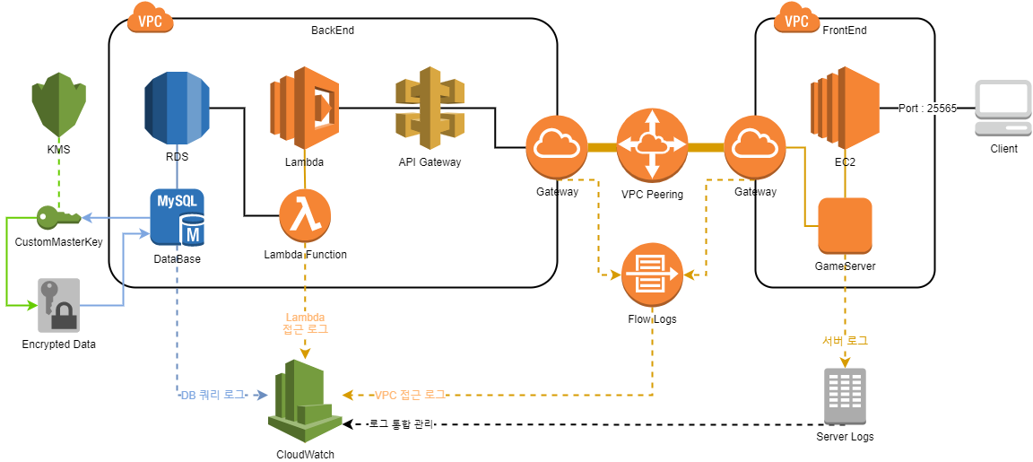
○○○●○○○○○○○○
Cloud IR Guide
Establish response objectives
Work with your stakeholders, legal counsel, and organizational leadership to determine the goal of responding to an incident.
(이해 관계자, 법률 고문 및 조직과 함께 사고 대응 목표를 결정하기)
Incident Response in the Cloud

Slide 5


○○○○●○○○○○○○
Cloud IR Guide
Cloud Watch
Indicators
RDS
General.log
EC2
Server Logs
Respond using the cloud
Implement your response patterns where the event and data occurs.
(이벤트 및 데이터가 발생하는 곳을 미리 확인하고, 대응 패턴 파악하기)
Incident Response in the Cloud

Slide 6
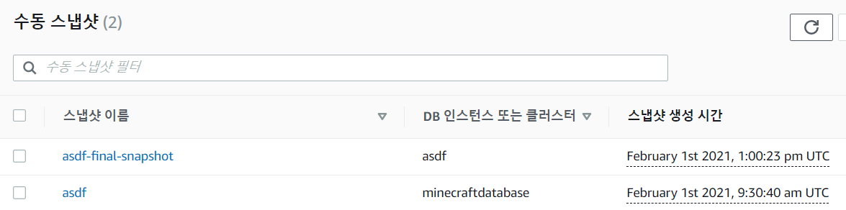

○○○○○●○○○○○○
Cloud IR Guide
Know what you have and what you need
Preserve logs, snapshots, and other evidence by copying them.
(로그, 스냅 샷 및 기타 필요한 증거를 복사하여 보존)
Incident Response in the Cloud

Slide 7
○○○○○○●○○○○○
Cloud IR Guide
Connect
Manager
RDS
Error
EC2
RDS
Use redeployment mechanisms
Make response mechanisms safe to execute
more than once and on unknown states.
(응답 메커니즘이 안전하게 수행 될 수 있도록 하기)
Incident Response in the Cloud

Slide 8

○○○○○○○●○○○○
Cloud IR Guide
Cloud Trail
Cloud Watch
Automate where possible
As you see issues or incidents repeat,
build mechanisms that programmatically.
(사고가 반복되면 프로그래밍 방식으로 상황을 분류하고 대응하기)
Incident Response in the Cloud

Slide 9

○○○○○○○○●○○○
Cloud IR Guide
Choose scalable solutions
Strive to match the scalability of
organization's approach to cloud computing.
(조직의 확장 성에 맞는 솔루션 선택하기)
Incident Response in the Cloud

Slide 10
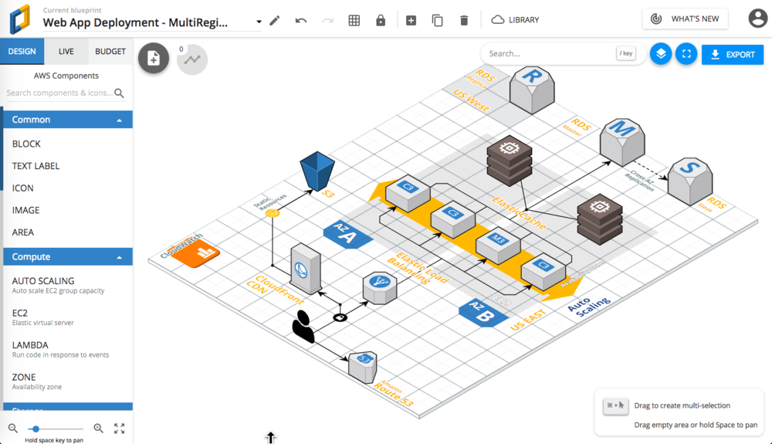
○○○○○○○○○●○○
Cloud IR Guide
Learn and improve process
Simulations are safe methods to find gaps and improve processes.
(시뮬레이션 및 학습을 통해 클라우드 프로세스를 개선한다)
Incident Response in the Cloud

Slide 11

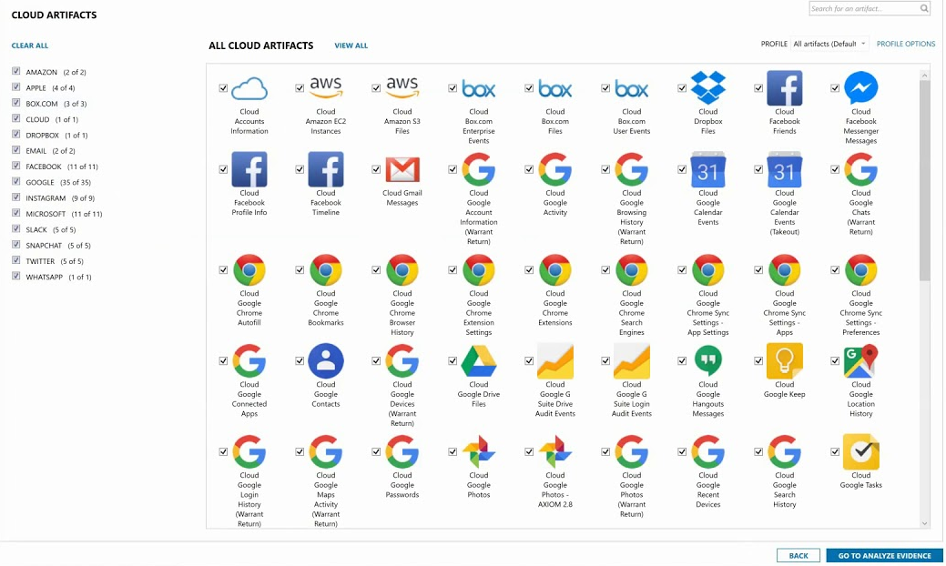
○○○○○○○○○○●○
Additional Things
Think about responding to an incident or a forensics event
In some cases, this means you may have multiple organizations,
accounts, and tools specifically set up for these response tasks.
(포렌식 관점으로도 생각 해 보고, 다양한 도구를 찾아 사용 해 보기)
Incident Response in the Cloud

Slide 12
Thankyou

